Slide 1

P peline
The Data
Byte 4
© Jennifer Mankoff
The Data Pipeline; HCII; Spring 2014

Slide 2
Agenda
Introduction to Mobile Data
Review
Quiz 3 Answers
Byte 4
Quiz 4

Slide 3
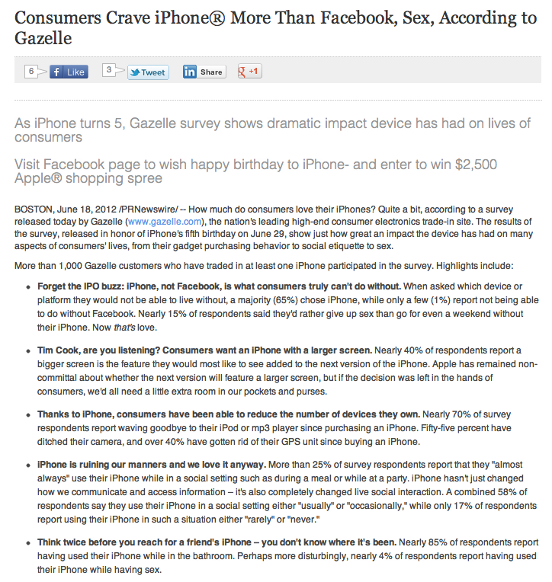
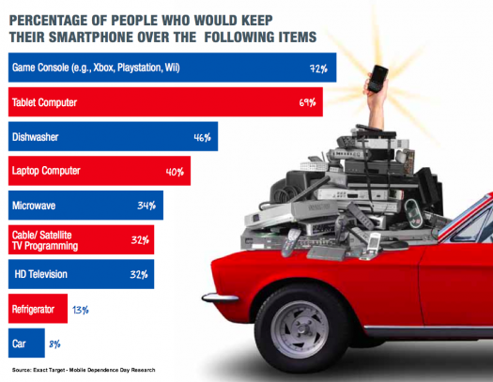
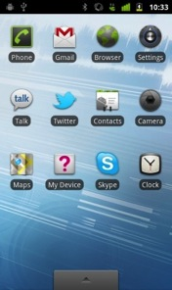
App Prediction [Ubicomp 2012]
To select next app
Required fewer user touches
Required less time
More accurate (88%) than existing methods
Some issues with dynamic UI
Smartphone addiction [in preparation]

Slide 4
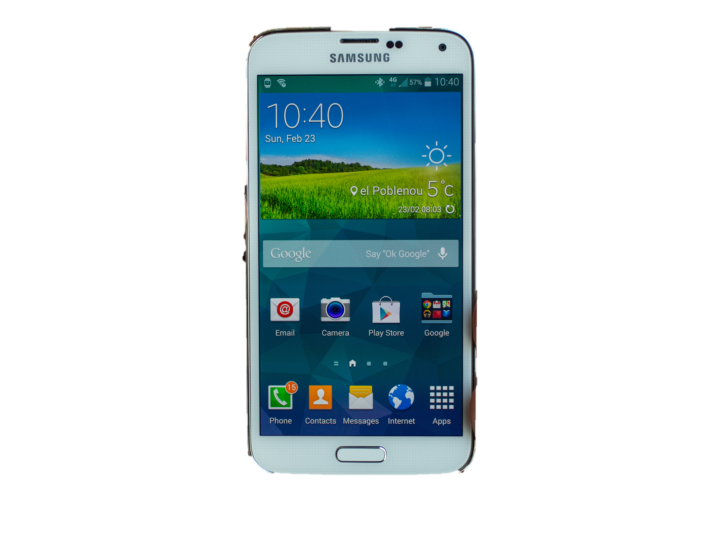
Mobile Data
People already carry phones
Can collect
Interactions with virtual information
Social engagement
Loads of sensors about physical actions

Slide 5
Sensors
Accelerometer
Applications
Battery
Bluetooth
Calls
Messaging
Gravity
Gyroscope
Light
Linear Accelerometer
Location
Magnetometer
Network Usage
Orientation
Pressure
Processor
Proximity
Rotation
Screen
Telephony
Temperature
Traffic
Wi-Fi
… many more

Slide 6
Big Data of 1
Build compelling and useful apps that provide value in everyday life and a compelling user experience
Think about what you can do with big data for 1 with origins in everyday activity
Notes:
Adaptive: accuracy, consistency of experience and interface, intelligibility: all problems we’re working on

Slide 7
Assumptions
We have made a number of WRONG assumptions about:
what smart phones are
how they are used
By removing assumptions, we can RE-CAST:
the notion of what a smart phone is
how to change usage behavior
how to perform behavioral imaging
how we can use them to improve people’s lives
how to leverage make (personalized) meaning from (your) big data
Notes:
We = the research community and now consumers

Slide 8
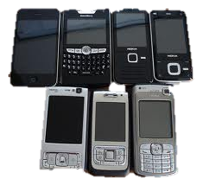
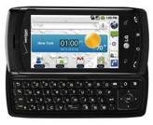
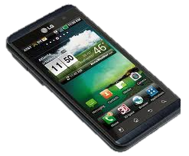
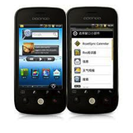
Assumption #1: We all have smart phones
What is a smart phone?
Android, iPhone, Nokia, Windows Mobile, Blackberry, …
Feature phone vs. smart phone
All Marketing
- “runs it’s own unique software but not a true and complete mobile OS”
- “runs a complete mobile OS”
- “offers more advanced computing ability and connectivity than a feature phone”
Notes:
----- Meeting Notes (1/26/12 10:17) -----
Assumption #1: we all have smart phones!

Slide 9
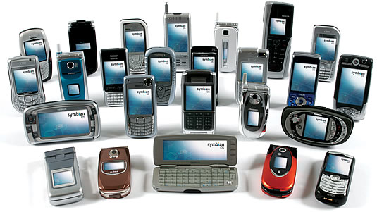
Dumb phones
We live in a time of dumb phones
Know almost nothing about me
Explicit preferences
Contacts
Running applications
Hardly knows when I’m mobile/fixed, charging/not charging
Doesn’t know me or what I’m doing
Why Not???

Slide 10
What we’d like instead: Context-aware phones
Input
User
System
Environment
Explicit
interaction
Implicit sensing
Application
Context-Aware
Application
Action
Action

Slide 11
Assumption #2: Usage
Put an app out there
People will find it and download it: not enough
Have to be able to find it on their phone
One study found: 177!!!
What do we know about apps people do use? [Banovic Mobile HCI 2014]
Notes:
I have 100 myself on my iPhone, and 350 on my iPad!

Slide 12
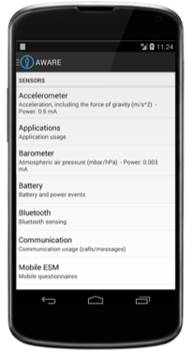
user study with
10 participants over period of 1 month
Notes:
We recruited 10 people over period of 1 month. And these were in many ways mobile power users that had high-end smart phones and used them on daily basis.

Slide 13

AWARE framework
Notes:
And we used the AWARE framework to collect information about their phones: their screen status, their application use, notifications, phone and text messages, and even location.

Slide 14
Assumption #2: Usage
Put an app out there
People will find it and download it: not enough
Have to be able to find it on their phone
One study found: 177!!!
What do we know about apps people do use?
95% of sessions shorter than 5 minutes; most < 60 secs
Notes:
I have 100 myself on my iPhone, and 350 on my iPad!

Slide 15
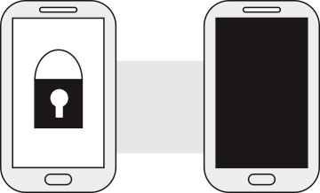
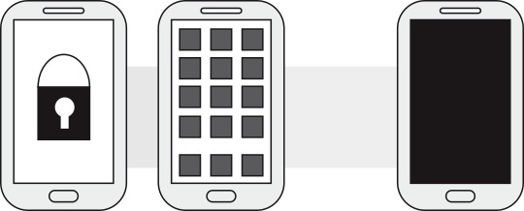
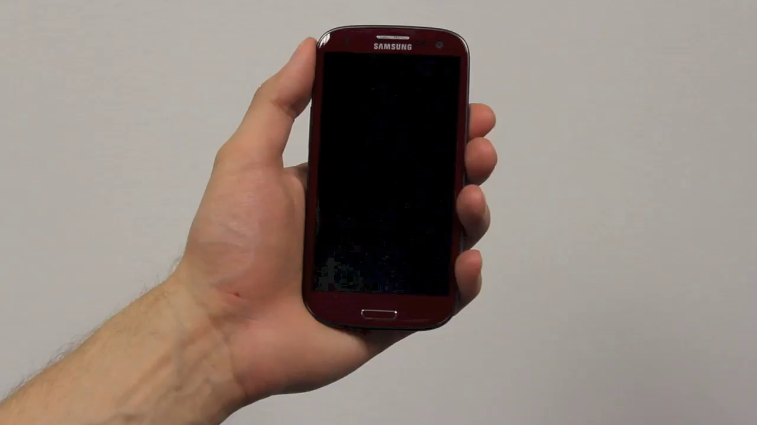
GLANCE
Notes:
We define, glances where the user turns on the screen, looks at the widgets on the lock screen and turns the screen off. Or alternatively, unlocks the screen but only looks at the notifications or widgets on the home screen.

Slide 16
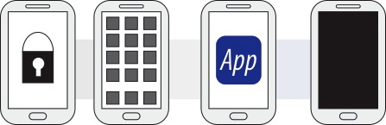
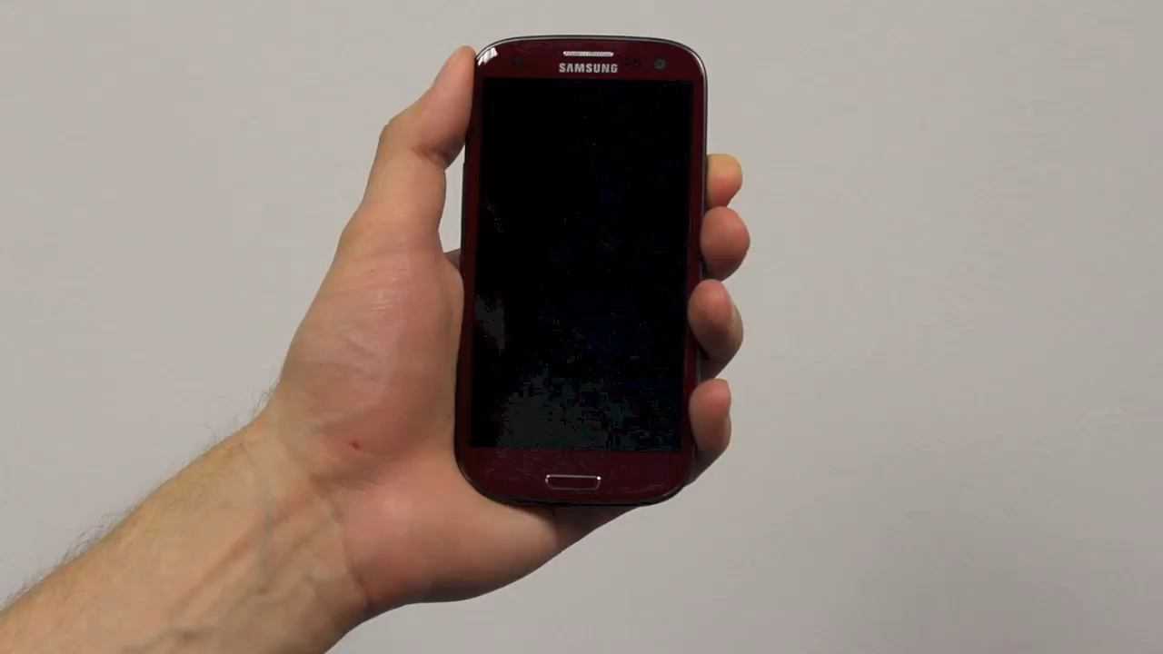
REVIEW
Notes:
Reviews, in which the user unlocks the phone and invokes one or more applications and uses these applications for less than 60 seconds. For example the user might review a text message and even respond to it quickly.

Slide 17
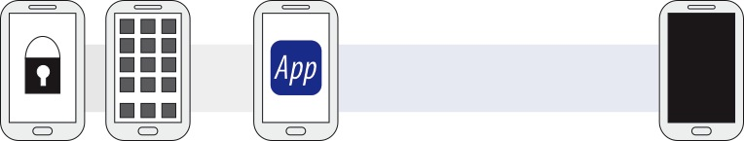
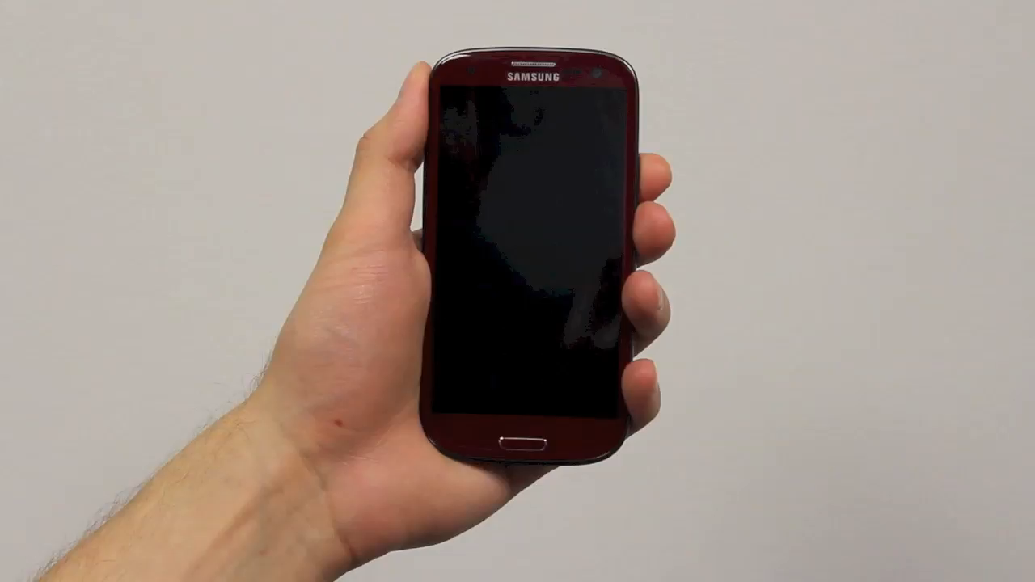
ENGAGE
Notes:
And engages, in which the user invokes one or more applications and interacts with them for longer than 60 seconds. For example, the user might engage in reading news and then watching movies on youtube.

Slide 18
Assumption #2: Usage
Put an app out there
People will find it and download it: not enough
Have to be able to find it on their phone
One study found: 177!!!
What do we know about apps people do use?
95% of sessions shorter than 5 minutes; most < 60 secs
Notifications lead to engagement…
Notes:
I have 100 myself on my iPhone, and 350 on my iPad!

Slide 19
Assumption #2: Usage
Put an app out there
People will find it and download it: not enough
Have to be able to find it on their phone
One study found: 177!!!
What do we know about apps people do use?
95% of sessions shorter than 5 minutes; most < 60 secs
Notifications lead to engagement… only 25% of the time!
Notes:
I have 100 myself on my iPhone, and 350 on my iPad!

Slide 20
Assumption #2: Usage
Put an app out there
People will find it and download it: not enough
Have to be able to find it on their phone
One study found: 177!!!
What do we know about apps people do use?
95% of sessions shorter than 5 minutes; most < 60 secs
Notifications lead to engagement… only 25% of the time!
Self-interruption therefore very common
Notes:
I have 100 myself on my iPhone, and 350 on my iPad!

Slide 21
Assumption #3: Usage
We assume that users have their phones with them and turned on 24-7
Necessary for
health-related, sustainability and other apps that model human behavior and are becoming so popular

Slide 22
Assumption #3: Usage
Why phone state matters:
Mobile phone is personal and travels with the user
Proxy for user context
Proxy for user’s environment context
Proxy for user’s attention/display device
Provide always-available service
But what if we are wrong?!?!

Slide 23
Assumption #3a: Usage
How much of the day is your phone on?
Average user: 78-81% [Anind K. Dey, Katarzyna Wac, Denzil Ferreira, Kevin Tassini, Jin-Hyuk Hong, Julian Ramos: Getting closer: an empirical investigation of the proximity of user to their smart phones. Ubicomp 2011: 163-172]
One-fifth of the time, phone is off
Can’t sense anything
Can’t show anything to the user
Notes:
24 – 100
22 – 92
20 – 83
18 – 75
12 – 50
6 – 25

Slide 24
Assumption #3b: Usage
When your phone is on, where is it?
Dey 2011
53% within arm’s reach
35% same room
12% further away
For ~2 hours a day, when the phone is on:
can’t use as a proxy for user context, environmental context, display device
Notes:
24 – 100
22 – 92
20 – 83
18 – 75
12 – 50
6 – 25

Slide 25
Summary: Usage Assumptions
Users have lots of apps competing for their attention
Can’t rely that their phone will be on
Can’t rely on the phone being a proxy

Slide 26
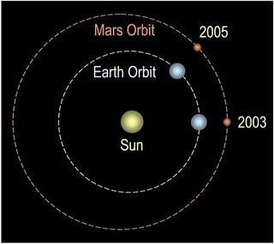
Other challenges
Battery
Raw sensors not behavior data
Not the sensors we always want
Computational complexity
Latency in communication
Basic software framework to support apps that can adapt to user behavior
Apps that drive innovation

Slide 27
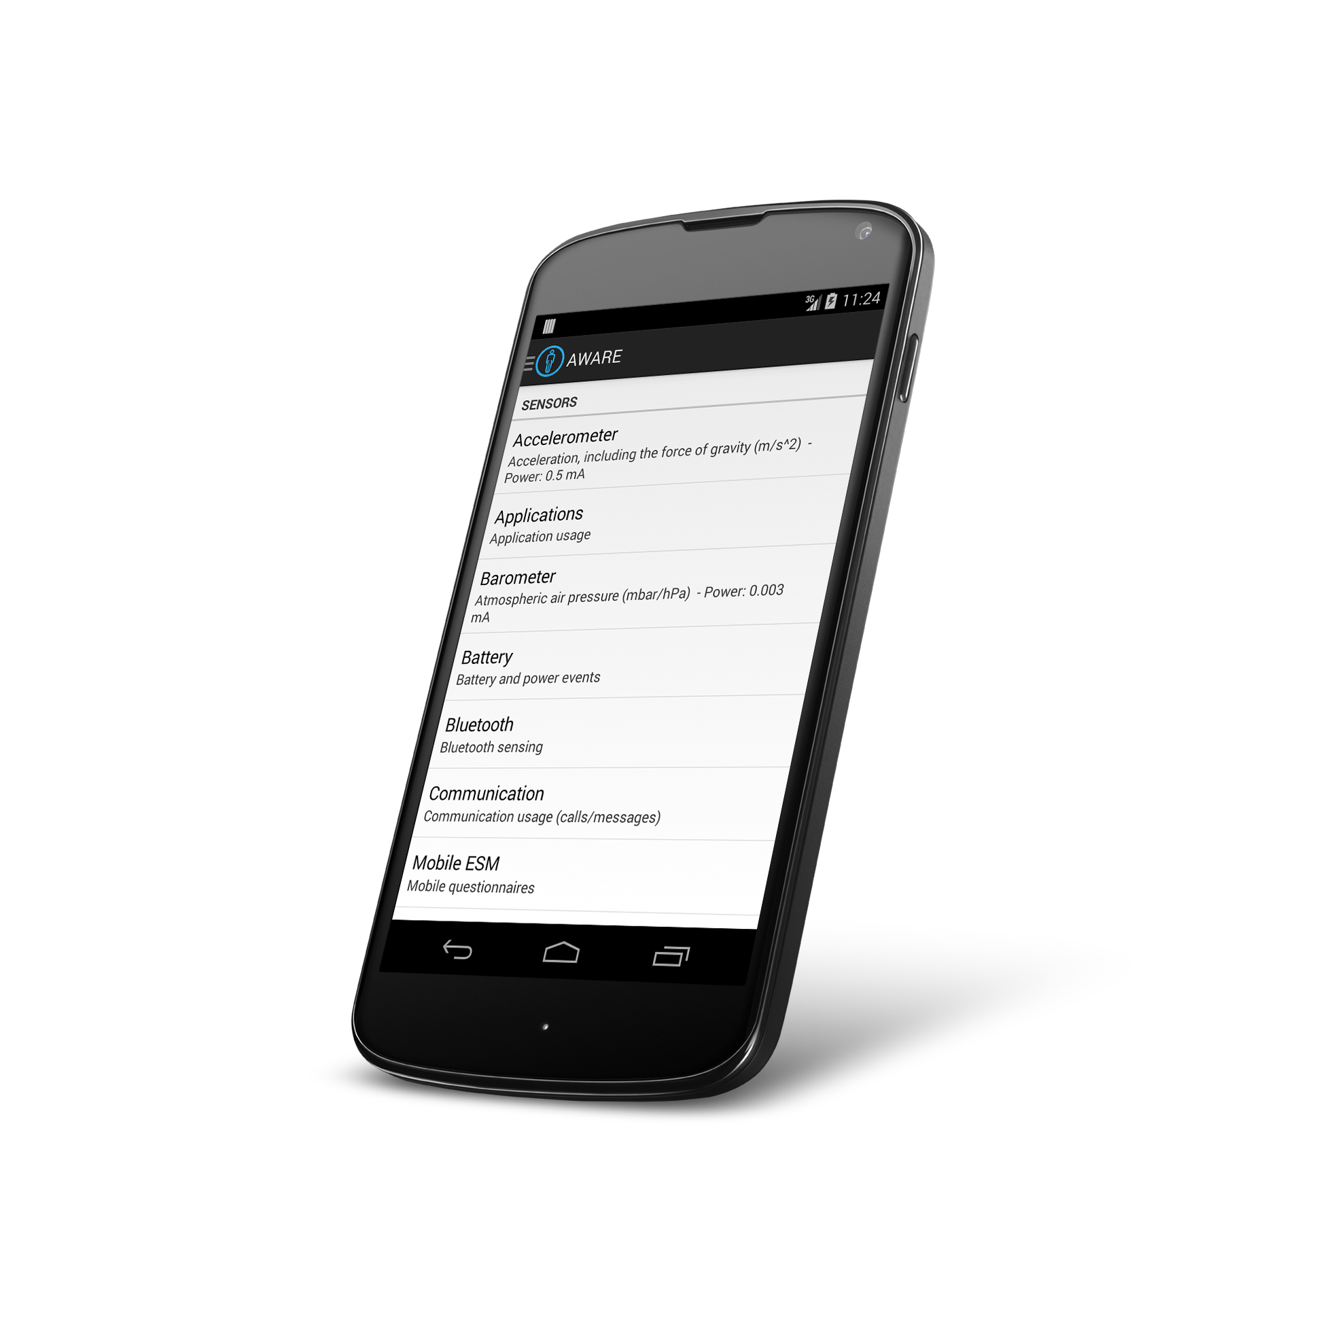
Aware Framework Dey & Ferreira (Oulu)
awareframework.com Collaborative mobile sensing for understanding human behavior and social wellbeing
Developer
Scientist
User

Slide 28
Overview
awareframework.com
User
Scientist
Developer

Slide 29
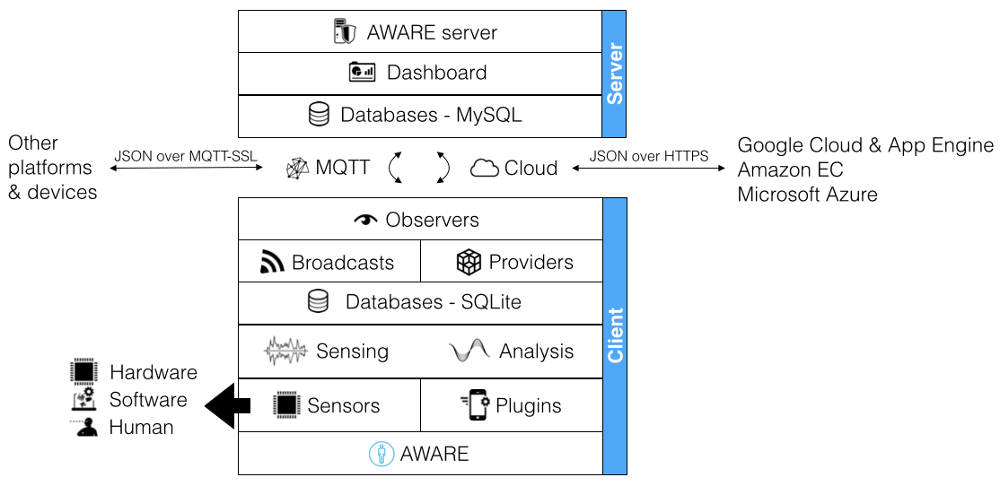
Architecture

Slide 30
Aware Sensors
GPS
Bluetooth
Battery
Wi-fi access point info
Cellular network info
Network traffic
Strategies for extending battery life: 12 hours
Accelerometer
Installed apps, running apps
Audio settings
Screen settings
Call/text/email/calendar logs
…
Notes:
Freely available to use: built

Slide 31
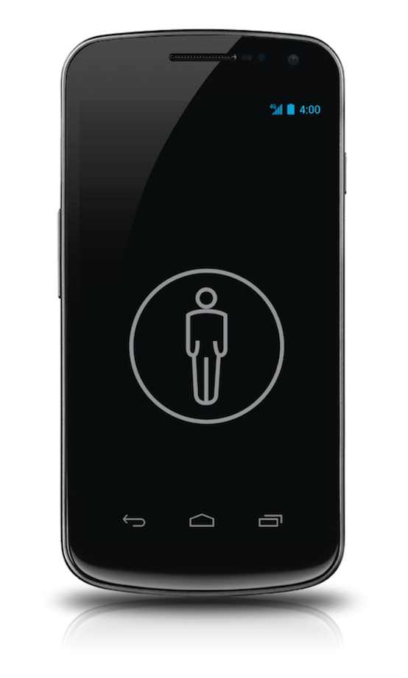


Plugins help with data interpretation:
Diet tracking
application
Accelerometer
Step counter
(plugin)
Activity Recognition
(plugin)
Calorie counter
(plugin)
noisy data
Mobility
application
REUSABILITY is the key here!

Slide 32


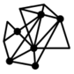


Ways to use AWARE
Dashboard
M2M
Databases
Large-scale, distributed studies, or personal studies:
AWARE-hosted or self-hosted databases
Concurrent studies
Study-specific or public plugins
Specify study’s active sensors
Enroll participants via a QRCode or a direct URL
Monitor the study’s status (e.g., amount of data, participation)
Remotely design and trigger mobile questionnaires (ESMs)

Slide 33
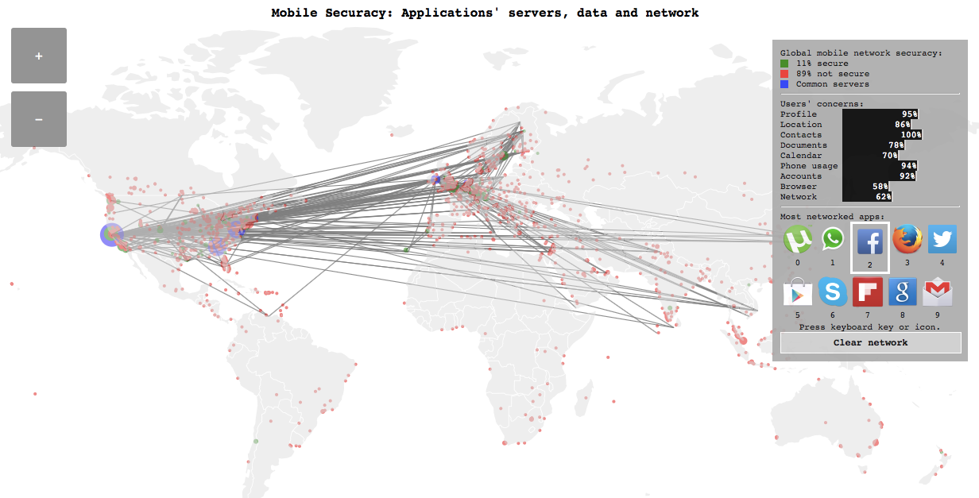
4830 devices worldwide
https://api.awareframework.com/index.php/world

Slide 34
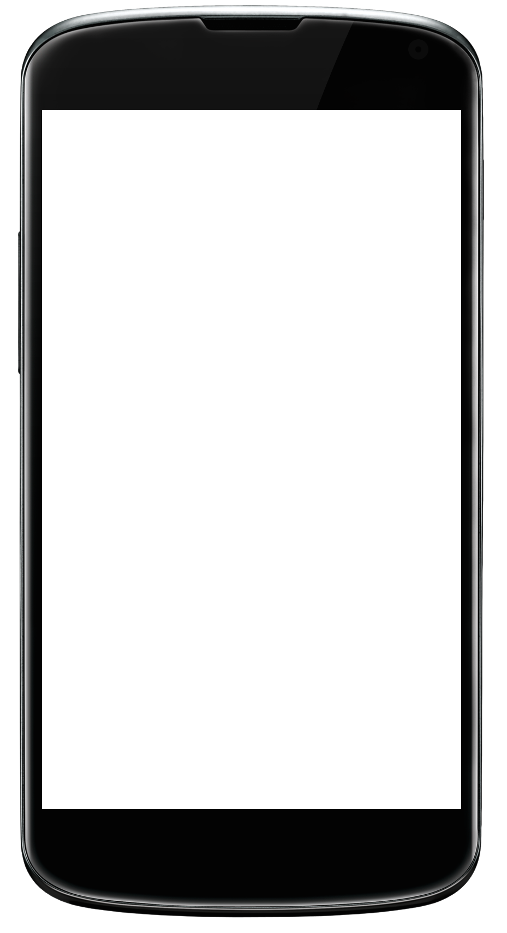
Phone-stression: quantifying someone’s frustrations when using their smartphones
Measurements:
Network problems/Network use
App crashes/App use
Screen adjustments/abuse
Light sensor/Pressure
Tapping frequency/Shaking
Repeated swipes to refresh
Accelerometer
Location not working
What frustrates you on your phone?
Notes:
Example project…

Slide 35
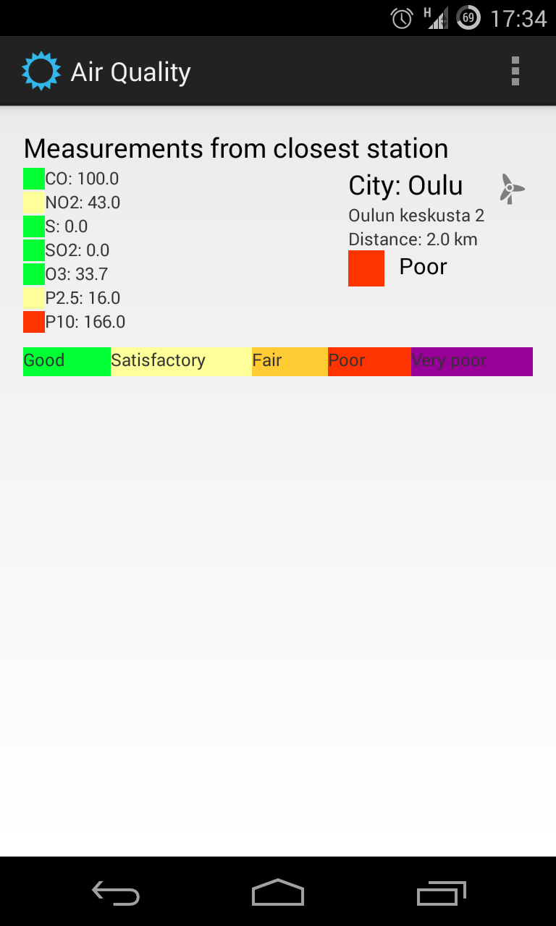
Asthma: weather, air quality, mobility and symptoms
Mood over time
Daily physical activity
Mobility range
Air quality exposure
Weather exposure
Asthma symptoms

Slide 36
Example: Student Life Study (!Aware)
[video]

Slide 37
Discussion

Slide 38
We’ve covered aspects of the whole pipeline
Question
Is it the right question?
Collect Data
Is it the right data for the question?
How hard/easy is it to collect?
Clean Data
What flaws exist in the data?
How do we address them?
Is it answerable?
Explore Data
Stats/Graphs/ML
Use data
Communicate/Predict/…
Intuition

Slide 39
But now we’re stopping here
Exploring multiple perspectives on data exploration & use
Multiple stakeholders
Multiple techniques (viz now, stats next, ml after that)
Multiple options (story telling, exploration, …)
Question
Is it the right question?
Collect Data
Is it the right data for the question?
How hard/easy is it to collect?
Clean Data
What flaws exist in the data?
How do we address them?
Is it answerable?
Explore Data
Stats/Graphs/ML
Use data
Communicate/Predict/…
Intuition

Slide 40
We talked about data exploration (doing the last two steps for you)
Transformations such as normalization, logs, and feature creation
Plots and their value – stem & leaf; boxplot; histogram
Distributions and some of their underlying assumptions; relating this back to your understanding of the data

Slide 41
We talked about visualization design (for others)
Key questions a viz author or viewer should ask about a viz
What is its goal?
Does it use good design?
Have there been usability studies done? What do they show?
Are data provenance & analysis approach documented
Notes:
(and do they match the goal?)

Slide 42
We discussed holistic design goals
Data & View Specifications | Visualize (choose encoding) Filter (focus on relevant items) Sort (expose patterns) Derive values or models
View Manipulation | Select (to highlight, filter, or manipulate) Navigate (zoom to examine patterns & detail) Coordinate (linked exploration) Organize windows and workspaces.
Process & Provenance | Record analysis histories Annotate patterns to document findings. Share views and annotations Guide users through analysis tasks or stories.
Heer & Shneiderman: Interactive Dynamics for Visual Analysis; ACM QUEUE, Feb 20, 2012
Notes:
Tailor to the application and the domain
Create highly interactive and integrated systems
Embed the visualization within a larger application
Provide alternative views

Slide 43
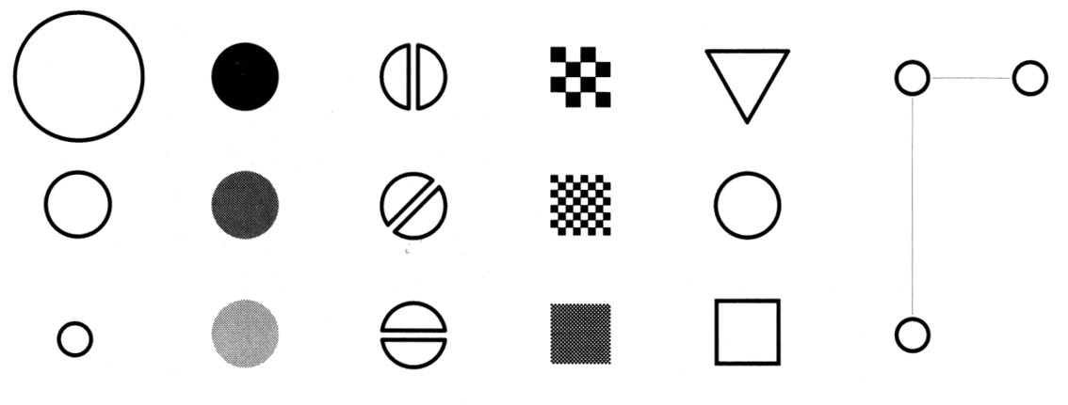
And specific techniques
Size
Value
Orientation
Texture
Shape
Position (2D / 3D)
Bertin’s ‘retinal variables’ form the basis for all forms of visual coding. A visual code can be based on (from left to right) contrasts of different types. Hue (chromatic color) provides an addition dimension not shown here.
Kevin Mullet and Darrell Sano, Designing Visual Interfaces
Slide from Marti Hearst/Jeff Heer via Jason Hong
Notes:
Note that while size and other cues provide for quantitative comparison, color (even luminance) only provides for ordering.
If the goal is contrast along any of these axes, make it distinct!

Slide 44
And we looked at many case studies (small and large)
Raised questions of context (social vs not; community structure)
Difficulty of separating viz & goals from application & goals
Difficulty of getting clear field vs lab results

